Slide 1
Movie DataBase
Notes:
This template can be used as a starter file for a photo album.

Slide 2
In this database we have 15 tables, 28 queries including crosstabs and parametric queries, 14 forms which contains macros, 13 reports which is constant and parametric and a macro.
Introducing

Slide 3
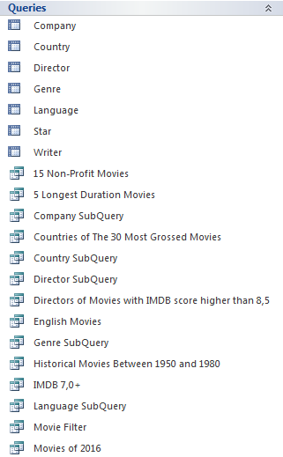
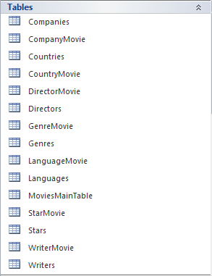
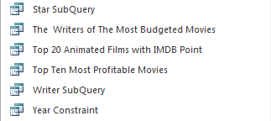
Tables
Queries

Slide 4
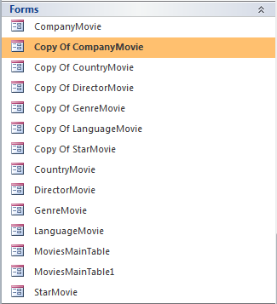
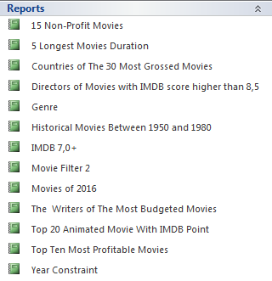
Reports
Forms

Slide 5
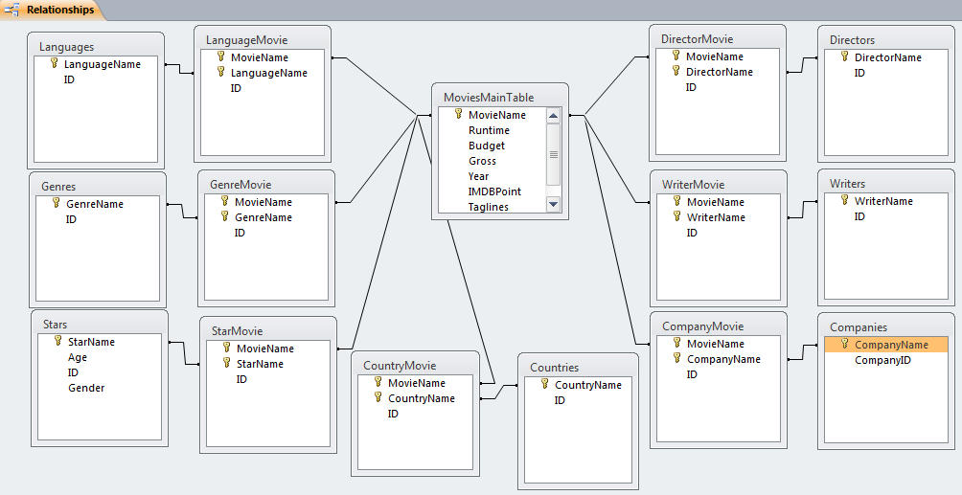

Slide 6
TABLES

Slide 7
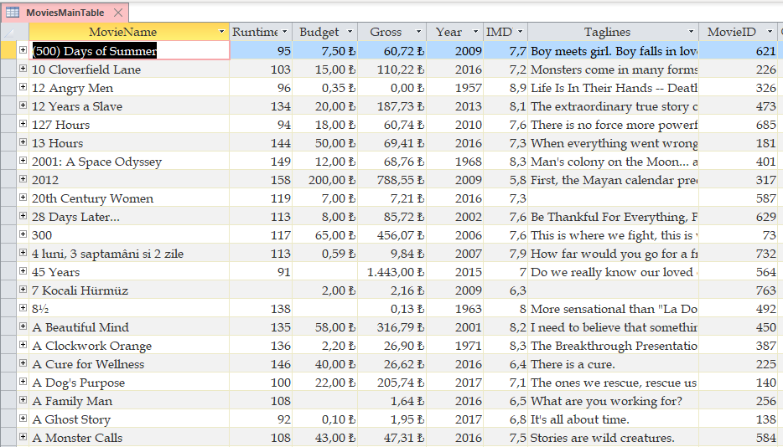

Slide 8
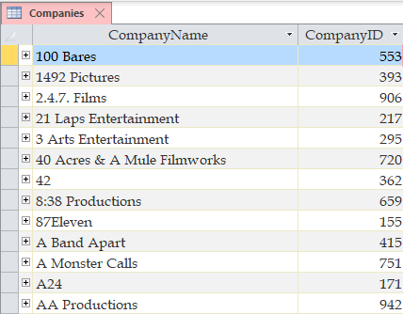
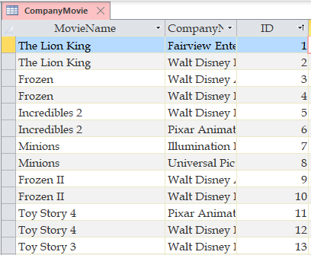
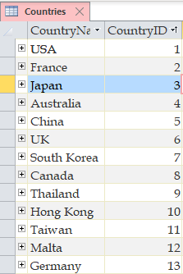
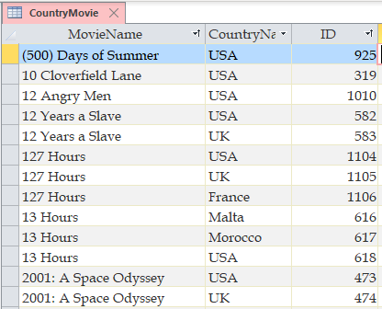

Slide 9
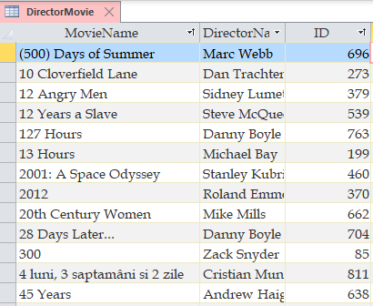
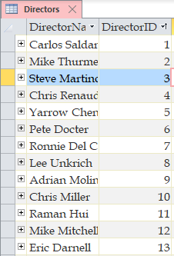
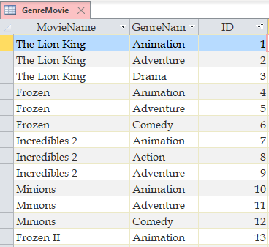
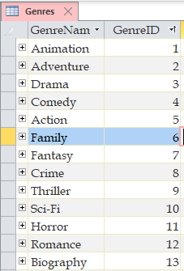

Slide 10
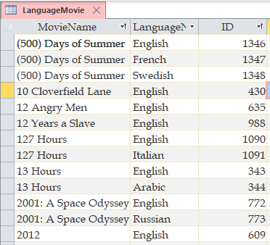
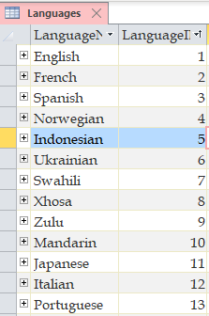
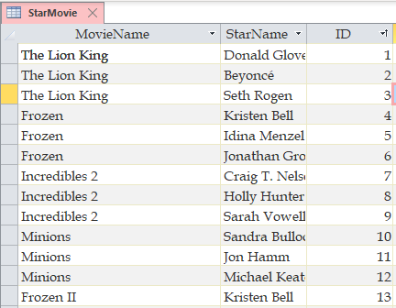
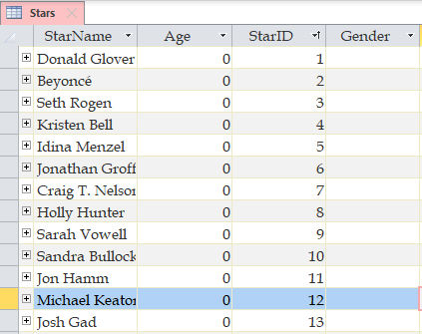

Slide 11
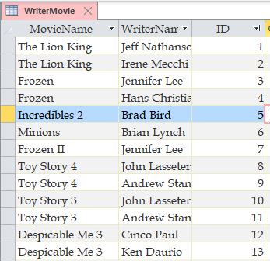
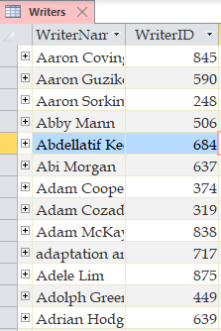

Slide 12
Queries

Slide 13
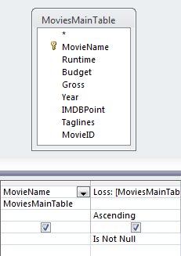
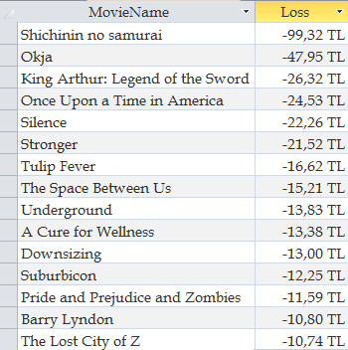
15 Non-Profit Movies
in Design View
15 Non-Profit Movies
in Datasheet View

Slide 14
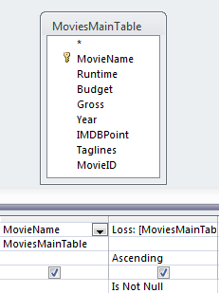
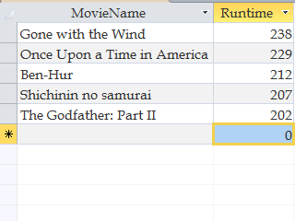
5 Longest Duration Movies
in Design View
5 Longest Duration Movies
in Datasheet View

Slide 15
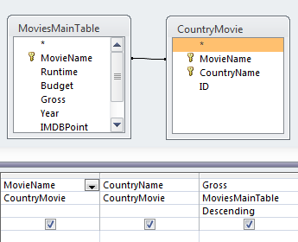
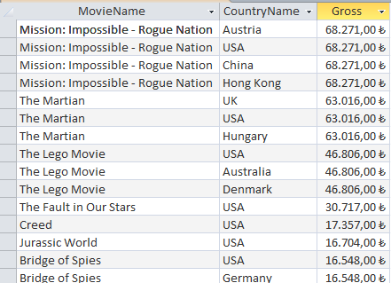
Countries of The 30 Most Grossed Movies in Design View
Countries of The 30 Most Grossed Movies in DataSheet View

Slide 16
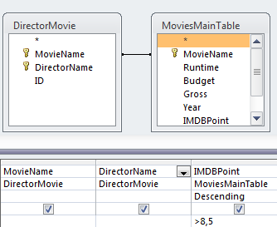
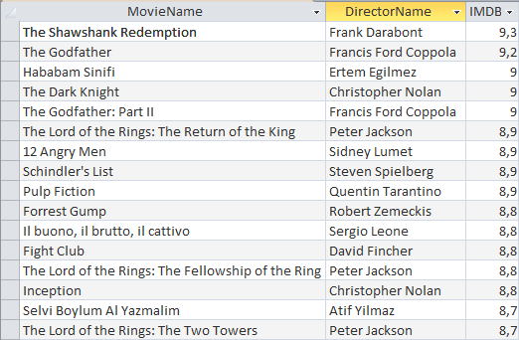
Directors of Movies with IMDB score higher than 8,5 in Design View
Directors of Movies with IMDB score higher than 8,5 in DataSheet View

Slide 17
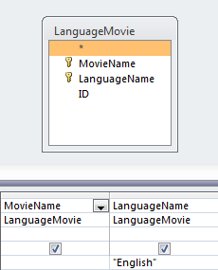
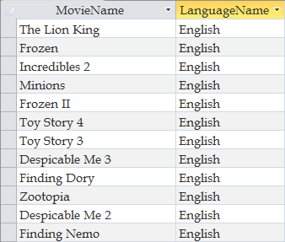
English Movies in Design View
English Movies in DataSheet View

Slide 18
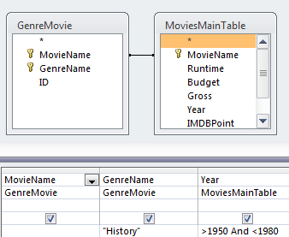
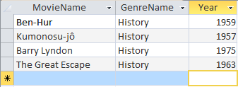
Historical Movies Between 1950 and 1980 in Design View
Historical Movies Between 1950 and 1980 in DataSheet View

Slide 19
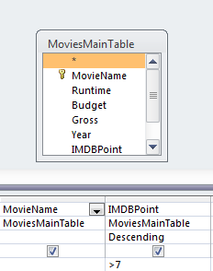
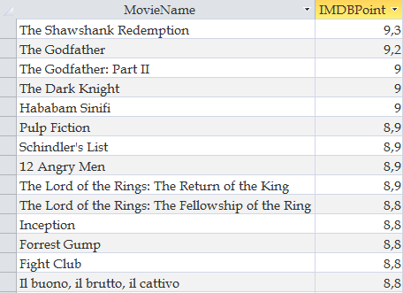
IMDB 7,0+ in Design View
IMDB 7,0+ in DataSheet View

Slide 20
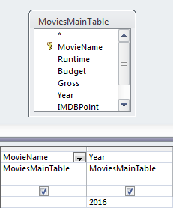
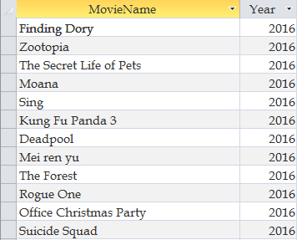
Movies of 2016 in Design View
Movies of 2016 in DataSheet View

Slide 21
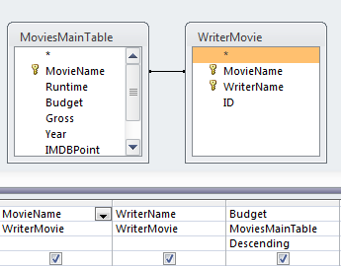
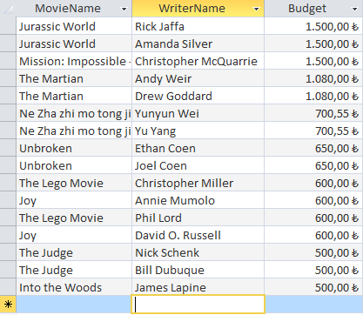
The Writers of The Most Budgeted Movies in Design View
The Writers of The Most Budgeted Movies in DataSheet View

Slide 22
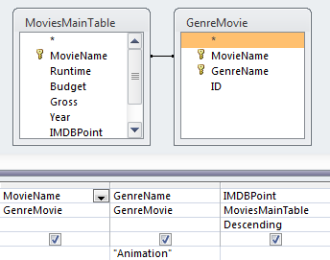
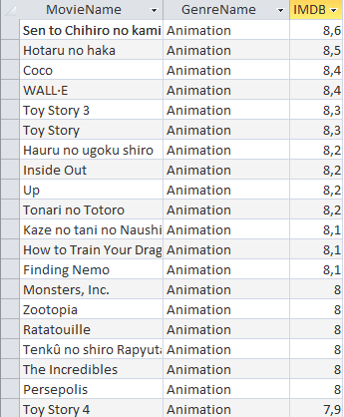
Top 20 Animated Films with IMDB Point in Design View
Top 20 Animated Films with IMDB Point in DataSheet View

Slide 23
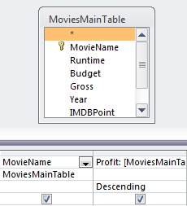
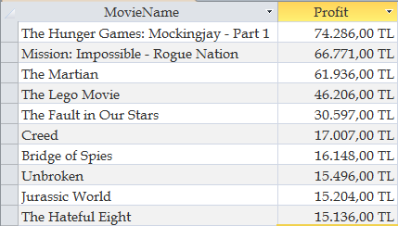
Top Ten Most Profitable Movies in Design View
Top Ten Most Profitable Movies in DataSheet View

Slide 24
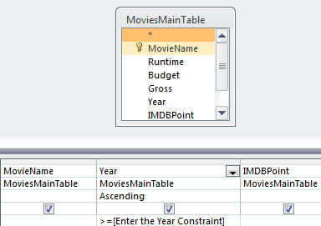
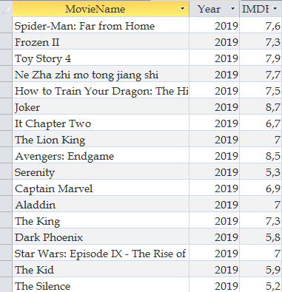
Year Constraint in in Design View
Year Constraint in DataSheet View

Slide 25


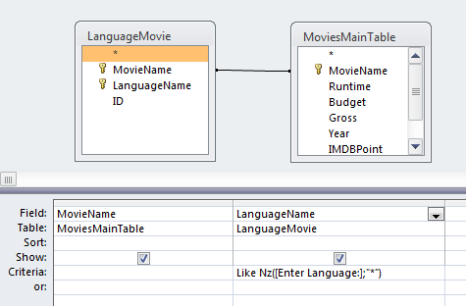


Language SubQuery

Slide 26
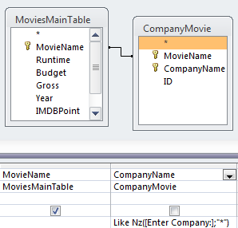
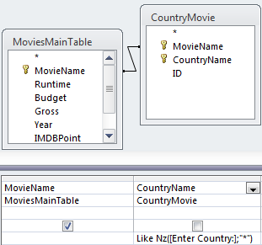
Company SubQuery
Country SubQuery

Slide 27
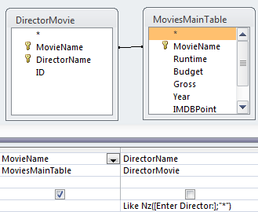
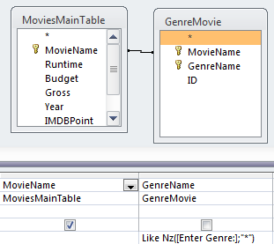
Director SubQuery
Genre SubQuery

Slide 28


Star SubQuery
Writer SubQuery

Slide 29









Slide 30
Forms

Slide 31





Slide 32





Slide 33


Slide 34







Slide 35
Reports

Slide 36


Slide 37


Slide 38


Slide 39


Slide 40

PARAMETRİC QUERY FOR GENRE EXAMPLE «ACTION»

Slide 41


Slide 42


Slide 43

PARAMETRİC QUERY FOR COUNTRY AND DIRECTOR EXAMPLE «USA,CHRISTOPHER NOLAN»

Slide 44


Slide 45


Slide 46


Slide 47


Slide 48

PARAMETRİC QUERY FOR YEAR EXAMPLE «1950»

Slide 49
Macros

Slide 50



Slide 51
Enes ince 11160000084 aleyna sinem ozenc 11150000030 elif kiliç 11150000090 bilal ayvazoğlu 11150000024
Hazırlayanlar

